Slide 1
Crowd Control: Armed with Rhetorical Force
Karen Trujillo and Jen England

Slide 2
Girlhood Remixed Camp
The Project: Digital literacy is becoming an increasingly important factor in academic, professional, and personal success. Yet research by the American Association of University Women (Tech Savvy, 2000) suggests that from 6th-8th grade, girls’ interest in technology wanes.
We propose a project that would encourage girls aged 11-14 to develop digital literacy. The project, titled Girlhood Remixed, will begin with a series of workshops in the Spring 2013 semester held after school at the NM State University campus, culminating in a three-day summer camp held at NMSU. Following the camp, girls will be invited to attend follow-up workshops to continue building upon their skills in the fall semester.

Slide 3
Camp Goals
Increase access to and skills in technology for girls, particularly in Dona Ana County, regardless of socioeconomic status
Increase critical awareness of new media consumption and production practices with particular attention paid to gender and identity representations available to young, female technology users
Encourage outreach work amongst undergraduate and graduate students from English and other departments – Students provided a variety of services to the camp from leading software demonstrations and working one-on-one with campers in the computer lab to serving meals and chaperoning evening events
Early recruitment for university

Slide 4
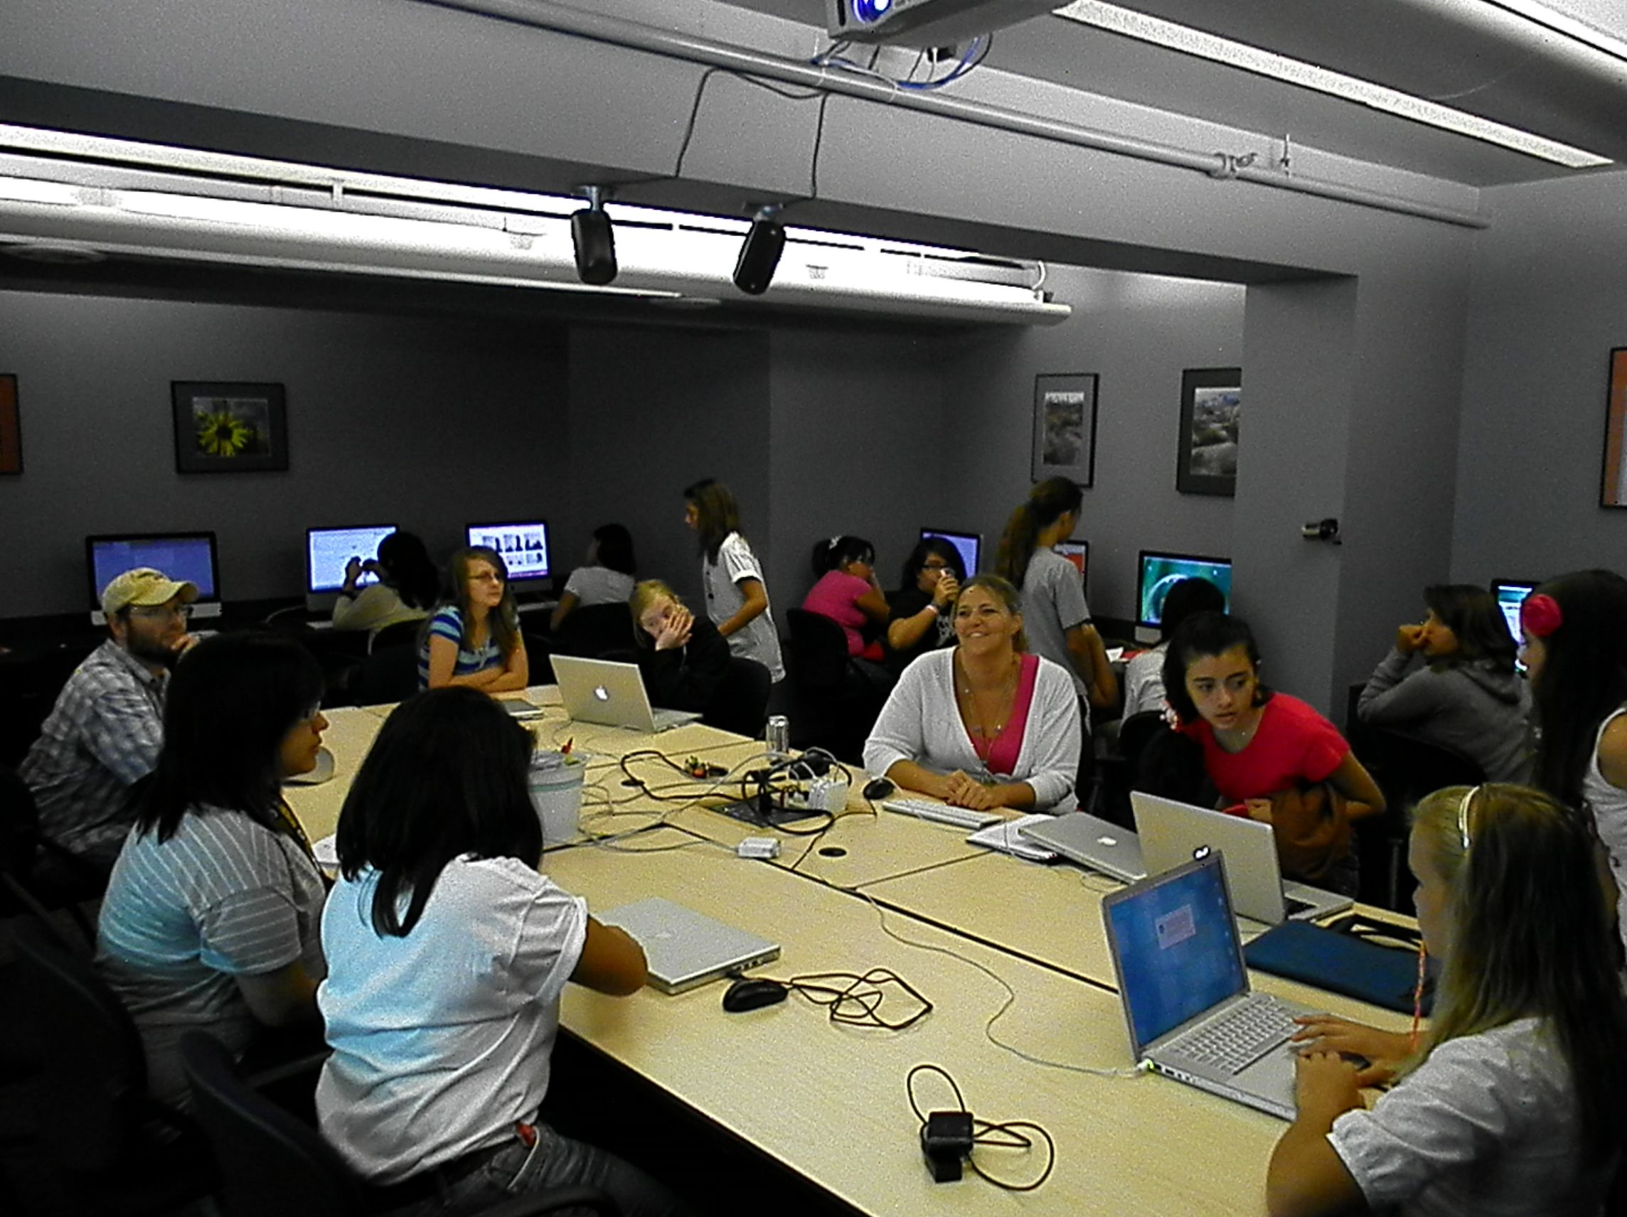
What Will They Do?
iMovie
Web design
PhotoShop
GarageBand
Blogging

Slide 5
Estimated Budget
Total budget for summer 2013 --- $2,774
  Two nights lodging for 24 campers and 4 chaperones (Housing costs are $21.50 per person, per night for double occupancy rooms) - $1,204
  Incidentals including craft supplies, snacks, and postage for permission forms and information packets - $400
  Three breakfasts, lunches, and dinners for 28 campers plus two additional volunteers at meal time (see chart below for breakdown) = $1,170

Slide 6
Where Will We Ask for $$?
Narrative rich marketing (email, Facebook, blog, traditional print media):
  Two nights lodging for 24 campers and 4 chaperones - $1,204
  Three breakfasts, lunches, and dinners for 28 campers plus two additional volunteers at meal time = $1,170
Limited narrative media (twitter, NMSU Student Hotline, Computers and Writing)
  Incidentals including craft supplies, snacks, and postage for permission forms and information packets - $400

Slide 7
The Role of Crowdsourcing
A way to take an audience of consumers and make them co-producers on a “project” without a mediating third party
Rhetorical and digital spaces that challenge us to rethink community building and action
Also known as crowdfunding
Notes:
http://www.youtube.com/watch?v=OI-bTpbkH4Y

Slide 8
Donors Choose
DonorsChoose.org is an online charity that provides a space where teachers can post a project request to help students in need. Project requests are posted from every corner of America, requesting that donors give any amount to the project that most inspires them.
When a project reaches its funding goal, Donors Choose will ship the materials to NMSU for Girlhood Remixed 2013. Donors will receive photos of the project taking place, a letter from the requesting party, and insight into how every dollar was spent. If a donor gives over $50, they also receive hand-written thank-yous from the students.

Slide 9
Indiegogo
Indiegogo is an international crowdfunding site that allows anyone the space to raise money for any type of project, event, cause, or charity. General categories for the site are “creative,” “cause,” and “entrepreneurial.” This is also a popular site for non-profit organizations.
If funded, Indiegogo projects work similarly to Donors Choose, where the crowd will receive set perks based on the amount of money donated. Crowdsourcers have two options for projects that don’t get fully funded: return all money to donators, or pay a percentage of the money collected to the site and keep the rest.

Slide 10
WAIT! Do We Even Need a Crowdsourcing Platform?
Resources
  Education in Rhetoric
  Social Media
  Access to faculty, student and personal contacts
  Reasonable monetary goal
  Time
Limitations
  Legal support
  We are trailblazers

Slide 11
The Role of Social Media
Facebook & Twitter
  Can be used to promote and share crowdsourcing platforms
  Can become remediated crowdsourcing spaces
  Can be used to solicit stories/narratives about using technology and relationships to/with technology

Slide 12
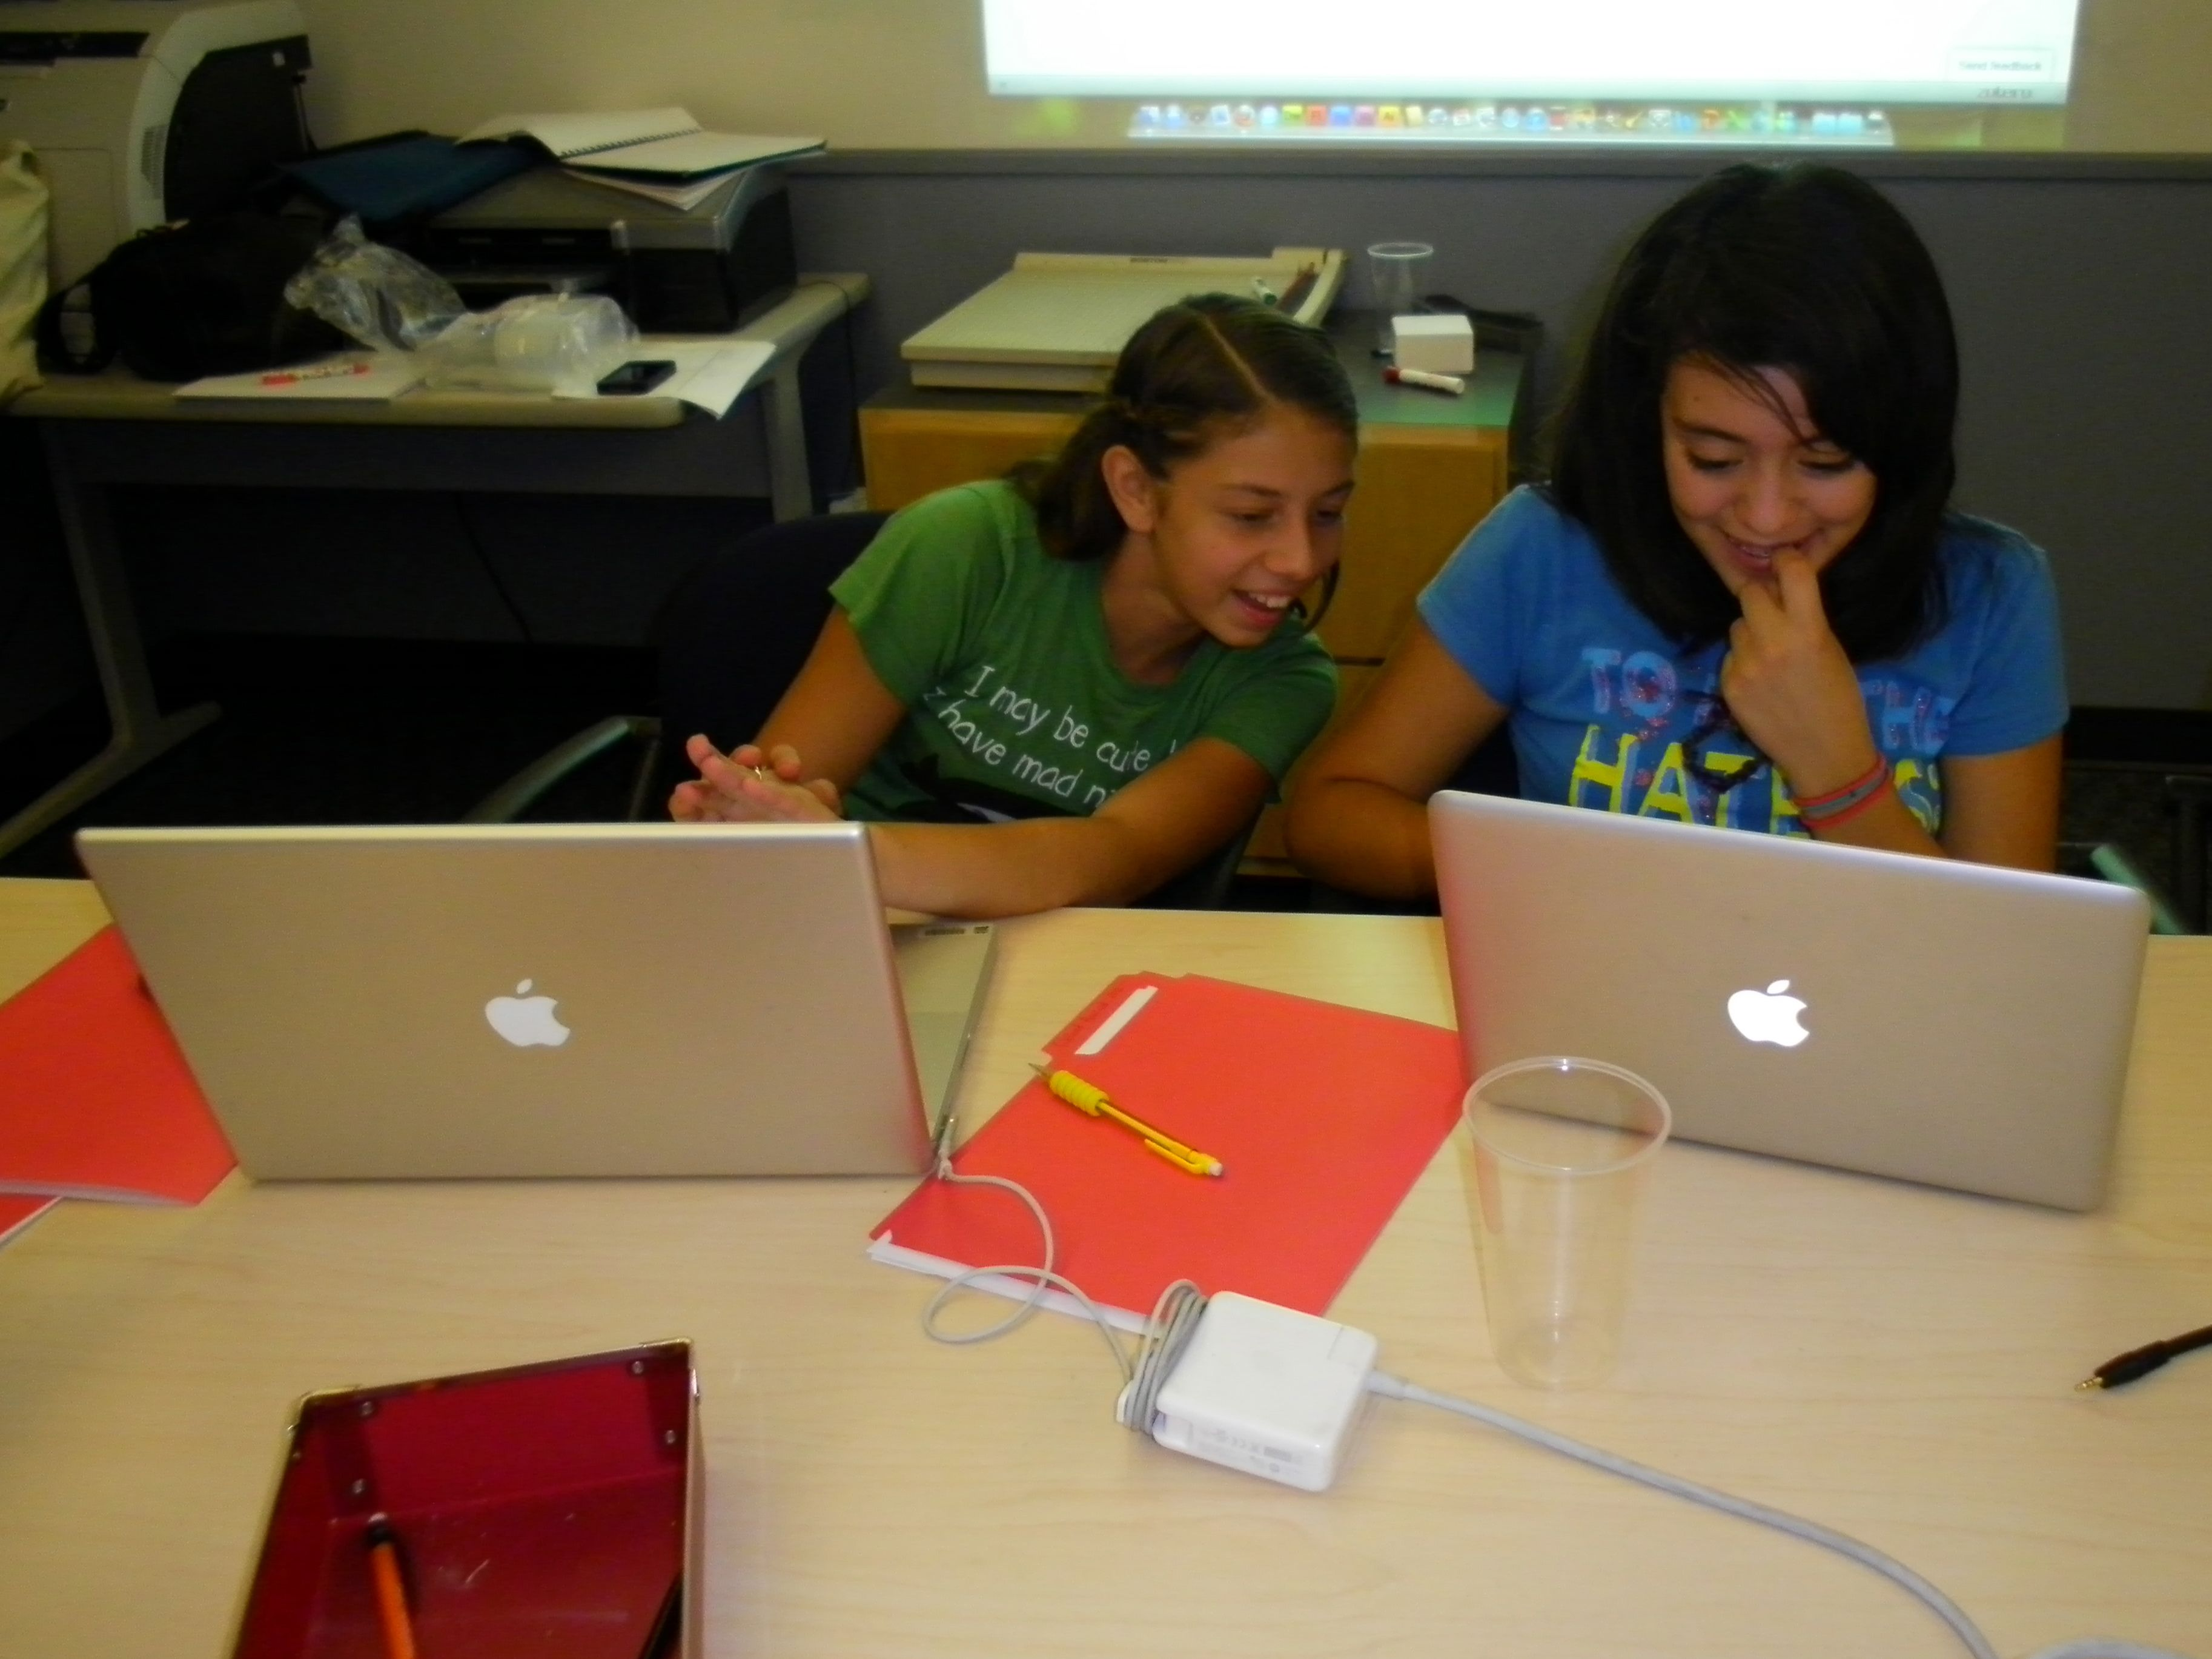
Storytelling
By creating a dialogue between ourselves as crowdsourcers and our target audiences, our crowd (or “customers”) for the platforms we will establish a space where technology stories can be shared and where transparency will be attended to.
We will invite and encourage our crowd (“customers”) to share in their girlhood technology stories as a way to inspire others and as a way of turning donators into more involved supporters of Girlhood Remixed
Likeable Social Media, Dave Kerpen

Slide 13
Storytelling Goals
We live by and through stories that include stories of personal transformation, and growth. Stories can change lives, and are the medium through which we live our lives.
By soliciting technology stories via numerous social media platforms, we will engage donors and the interested reader as “word of mouth” and digital marketers for the project.
We will requesting that readers post a story and/or re-post our request. Through this, hope to reach the sphere of influence of thousands.

Slide 14
Potential Findings
The role stories can play in encouraging shared experiences
  The ways in which shared experiences (emotional) can lead to feeling a connection with our research need: money for the camp (rational)
  The ways in which crowdsourcing platforms can act as sites/spaces for advocacy
  The rhetorical nature of crowdsourcing platforms
  The role social media can play in sharing stories, promoting advocacy, and remediating crowdsourcing sites

